Slide 1


Smart Warehouse Simulation
Capstone Project by Team 11

Slide 2
Role Distributions
Team Members | Roles
Usman Rangrez | Storage Submodule & GUI Frontend
Ali Shaaban | Equipment Submodule & UML Diagram
Ali Farzizada | Task Submodule & GUI backend
Priyanka Gupta | Logging Submodule & Component Diagram & ppt

Slide 3
Description of Domain
3D Warehouse Grid - Full 3D storage with rows × columns × levels
Automated AGVs - Self-coordinating autonomous guided vehicles
Smart Task - Intelligent Task management and Task queue
Real-Time Logging - Comprehensive activity tracking
Exception Handling - Robust error management
Thread-Safe Operations - Handles concurrent operations without race conditions

Slide 4
Requirements of System
Java JDK 21+
JUnit Platform Console Standalone 6.0.1
OPenJFX 21+

Slide 5
Equipment Module
Creating Charging Stations
Creating Equipment (AGV Shuttle and Crane )
Managing Equipment

Slide 6
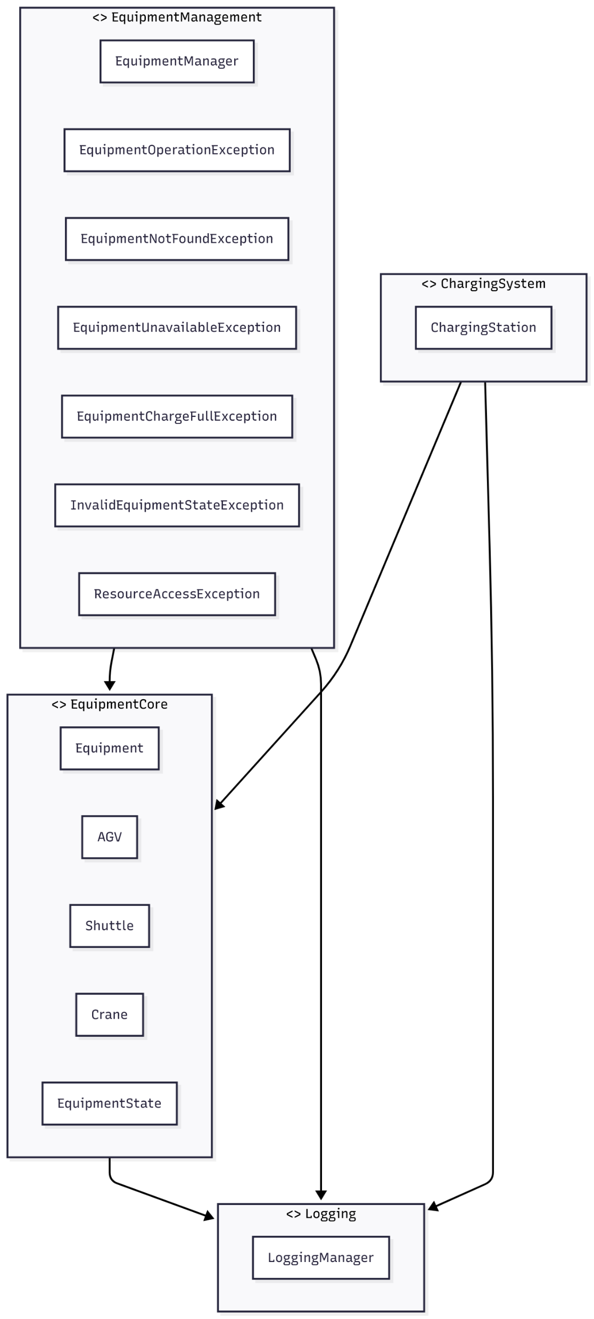
Component Diagram
Equipment Manager
Equipment Abstract Class
Charging System
Logging

Slide 7
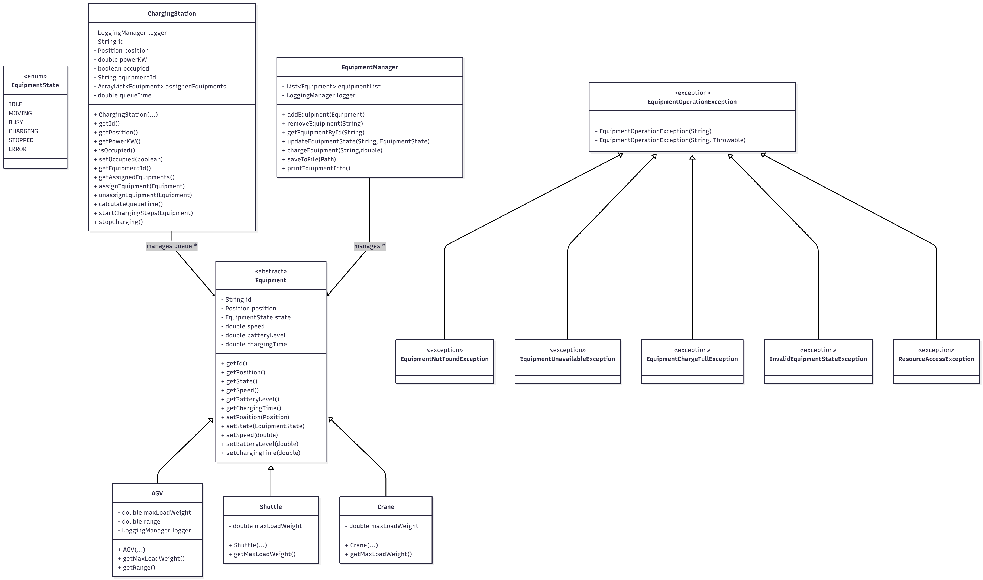
UML Class Diagram

Slide 8
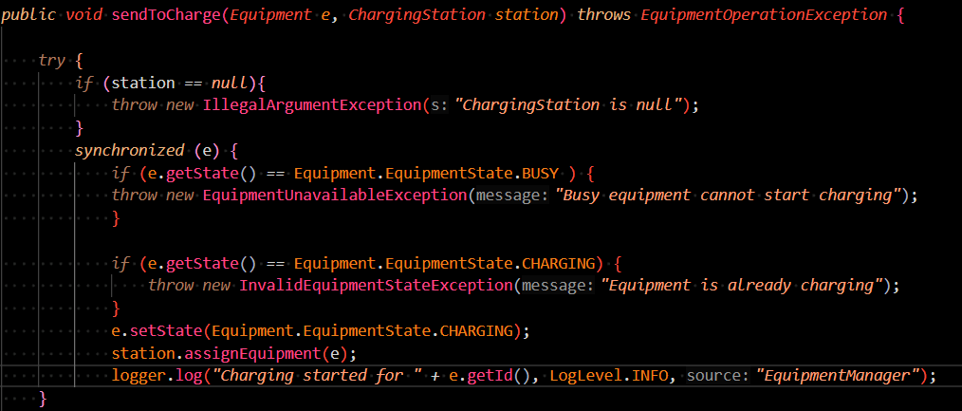
Thread Safe Approach

Slide 9
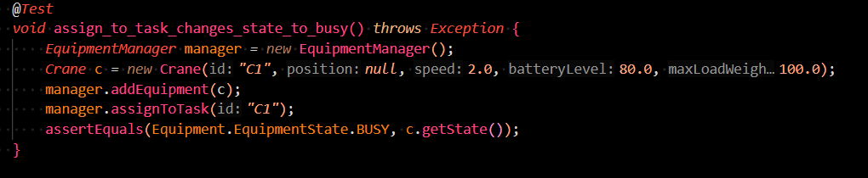
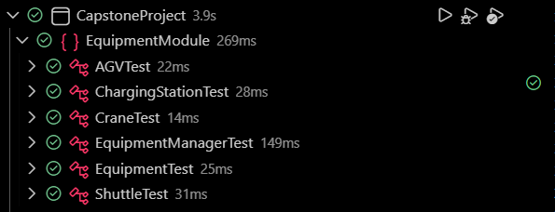
Unit Tests

Slide 10
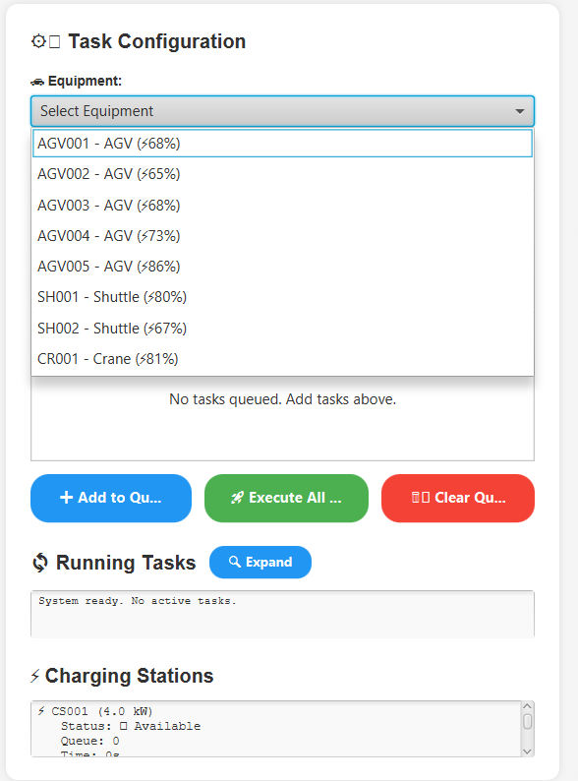
Equipments in GUI

Slide 11
Storage Module
Creating Storage as 3D warehouse
Creating Subcomponents of Warehouse
Managing via Storage Manager

Slide 12
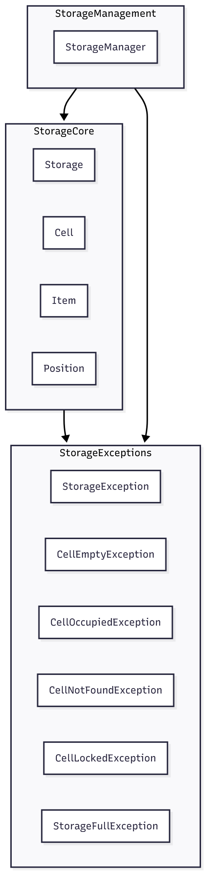
Component Diagram
Storage Management
Storage Core
Storage Exceptions

Slide 13
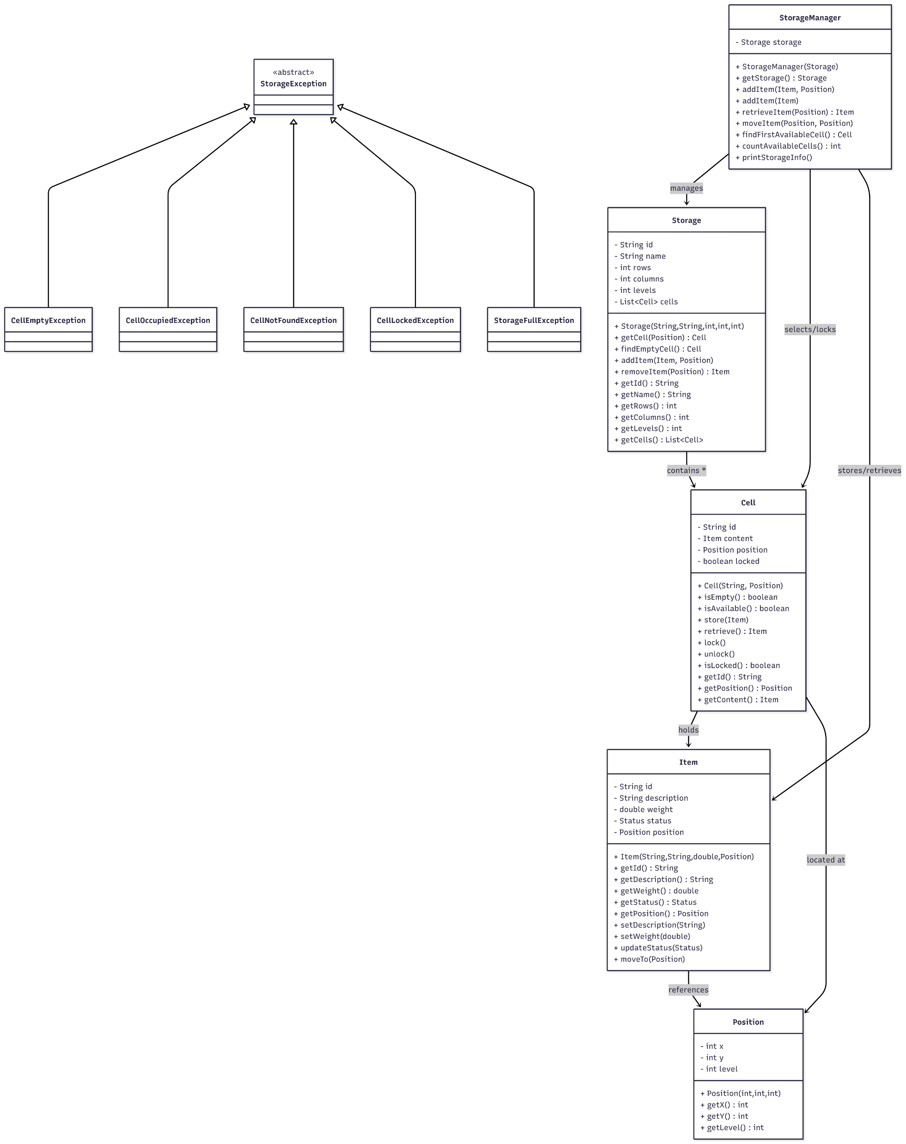
UML Class Diagram
Storage Manager
Storage
Cell
Item
Position
Storage Exception

Slide 14
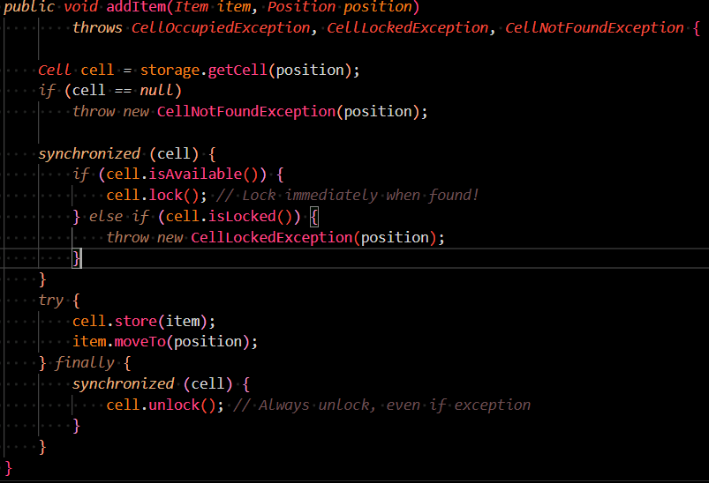
Thread Safe Approach

Slide 15
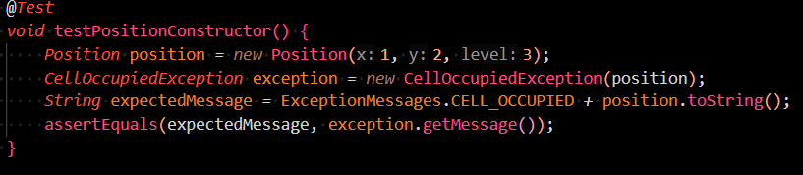
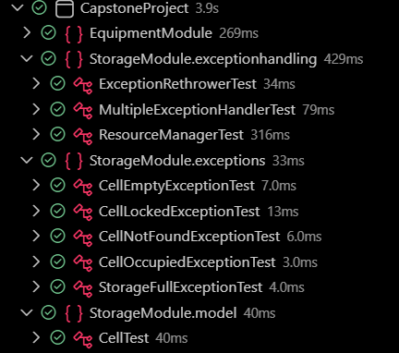
Unit Tests

Slide 16
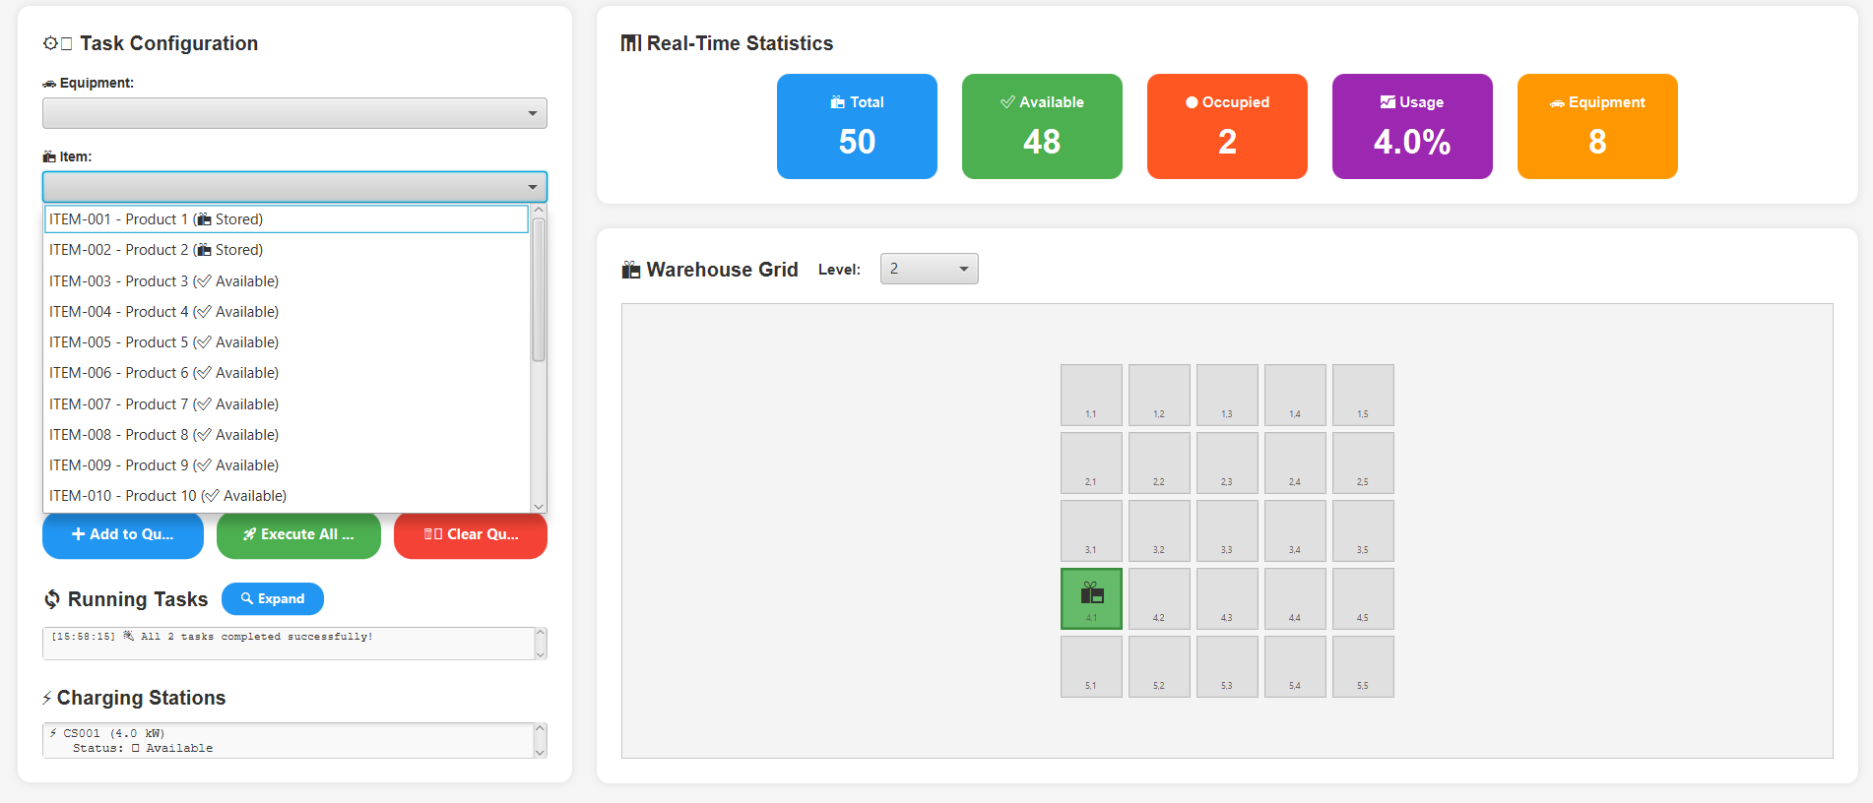
Storage in GUI

Slide 17
Logging Module
Providing Single Static Instance for Logging
Writing, Saving and Deleting logs

Slide 18
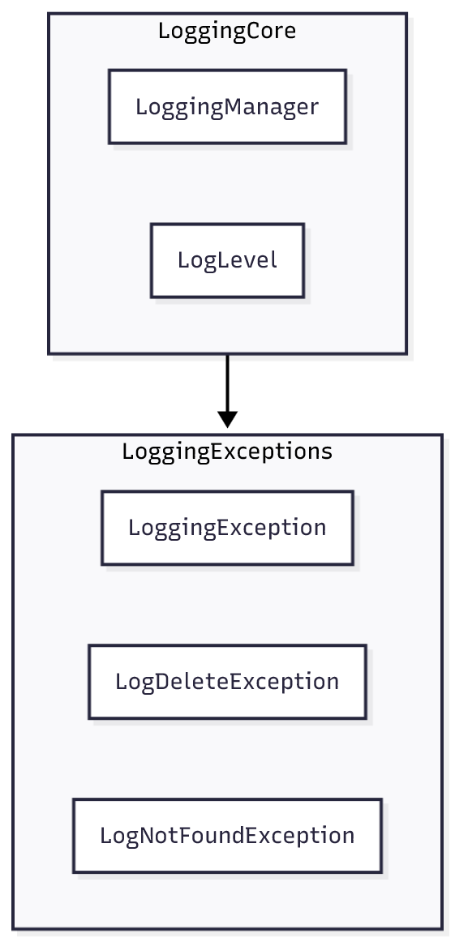
Component Diagram
Logging Manager
Log Level
Loggin Exceptions

Slide 19
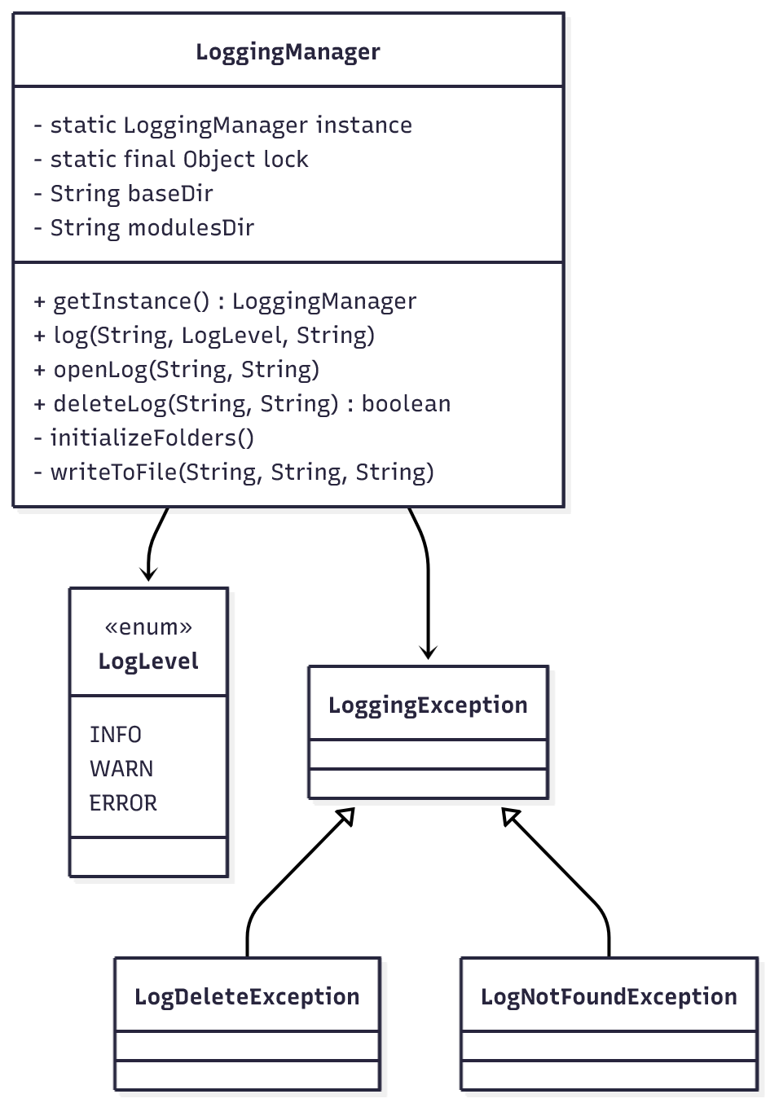
UML Class Diagram
Logging Manager
Log Level
Loggin Exception

Slide 20
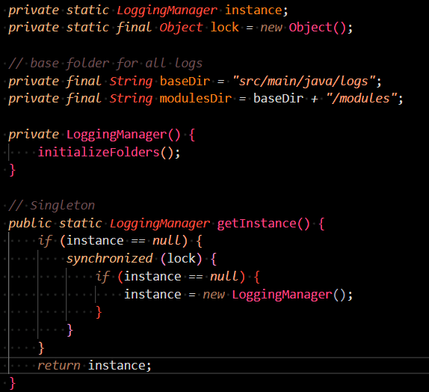
Thread Safe Approach

Slide 21
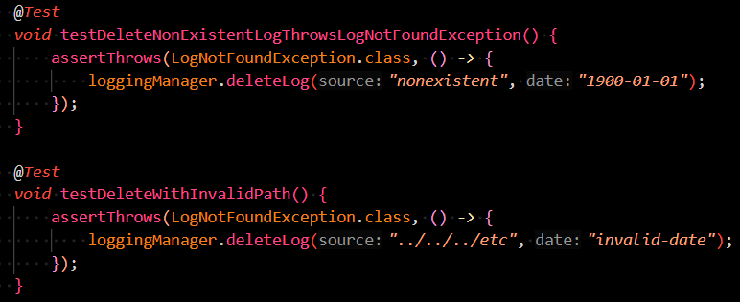
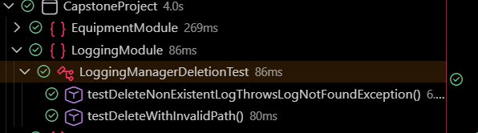
Unit Tests

Slide 22
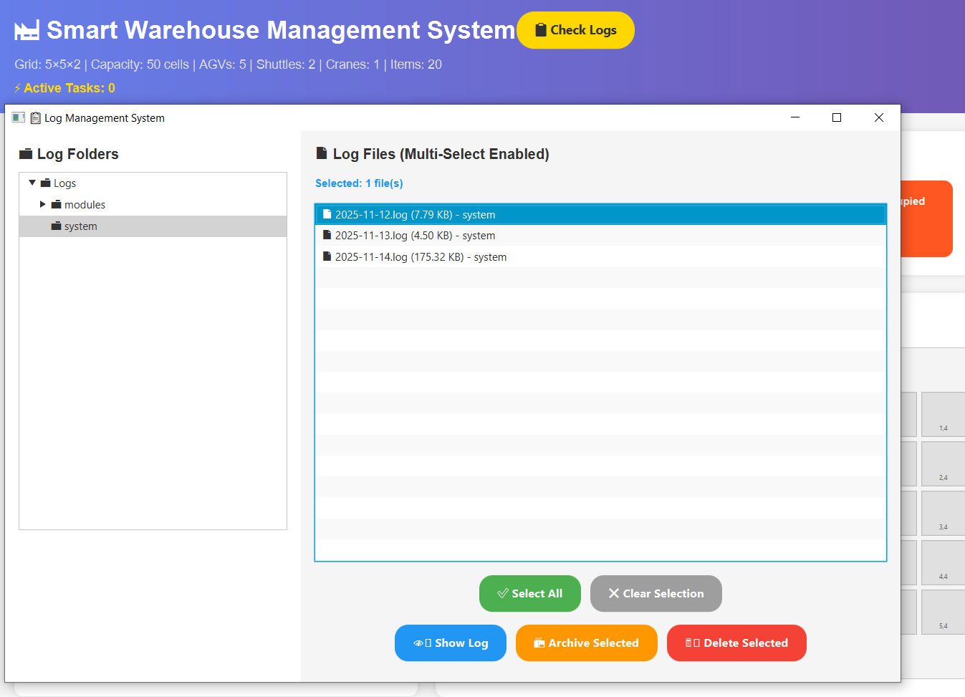
Logging in GUI

Slide 23
Task Module
Implementing Task as Runnable
Managing Tasks

Slide 24
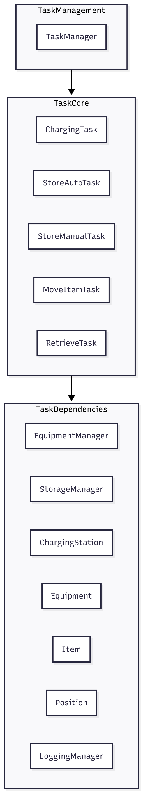
Component Diagram
Task Management
Task Core
Task Dependencies

Slide 25
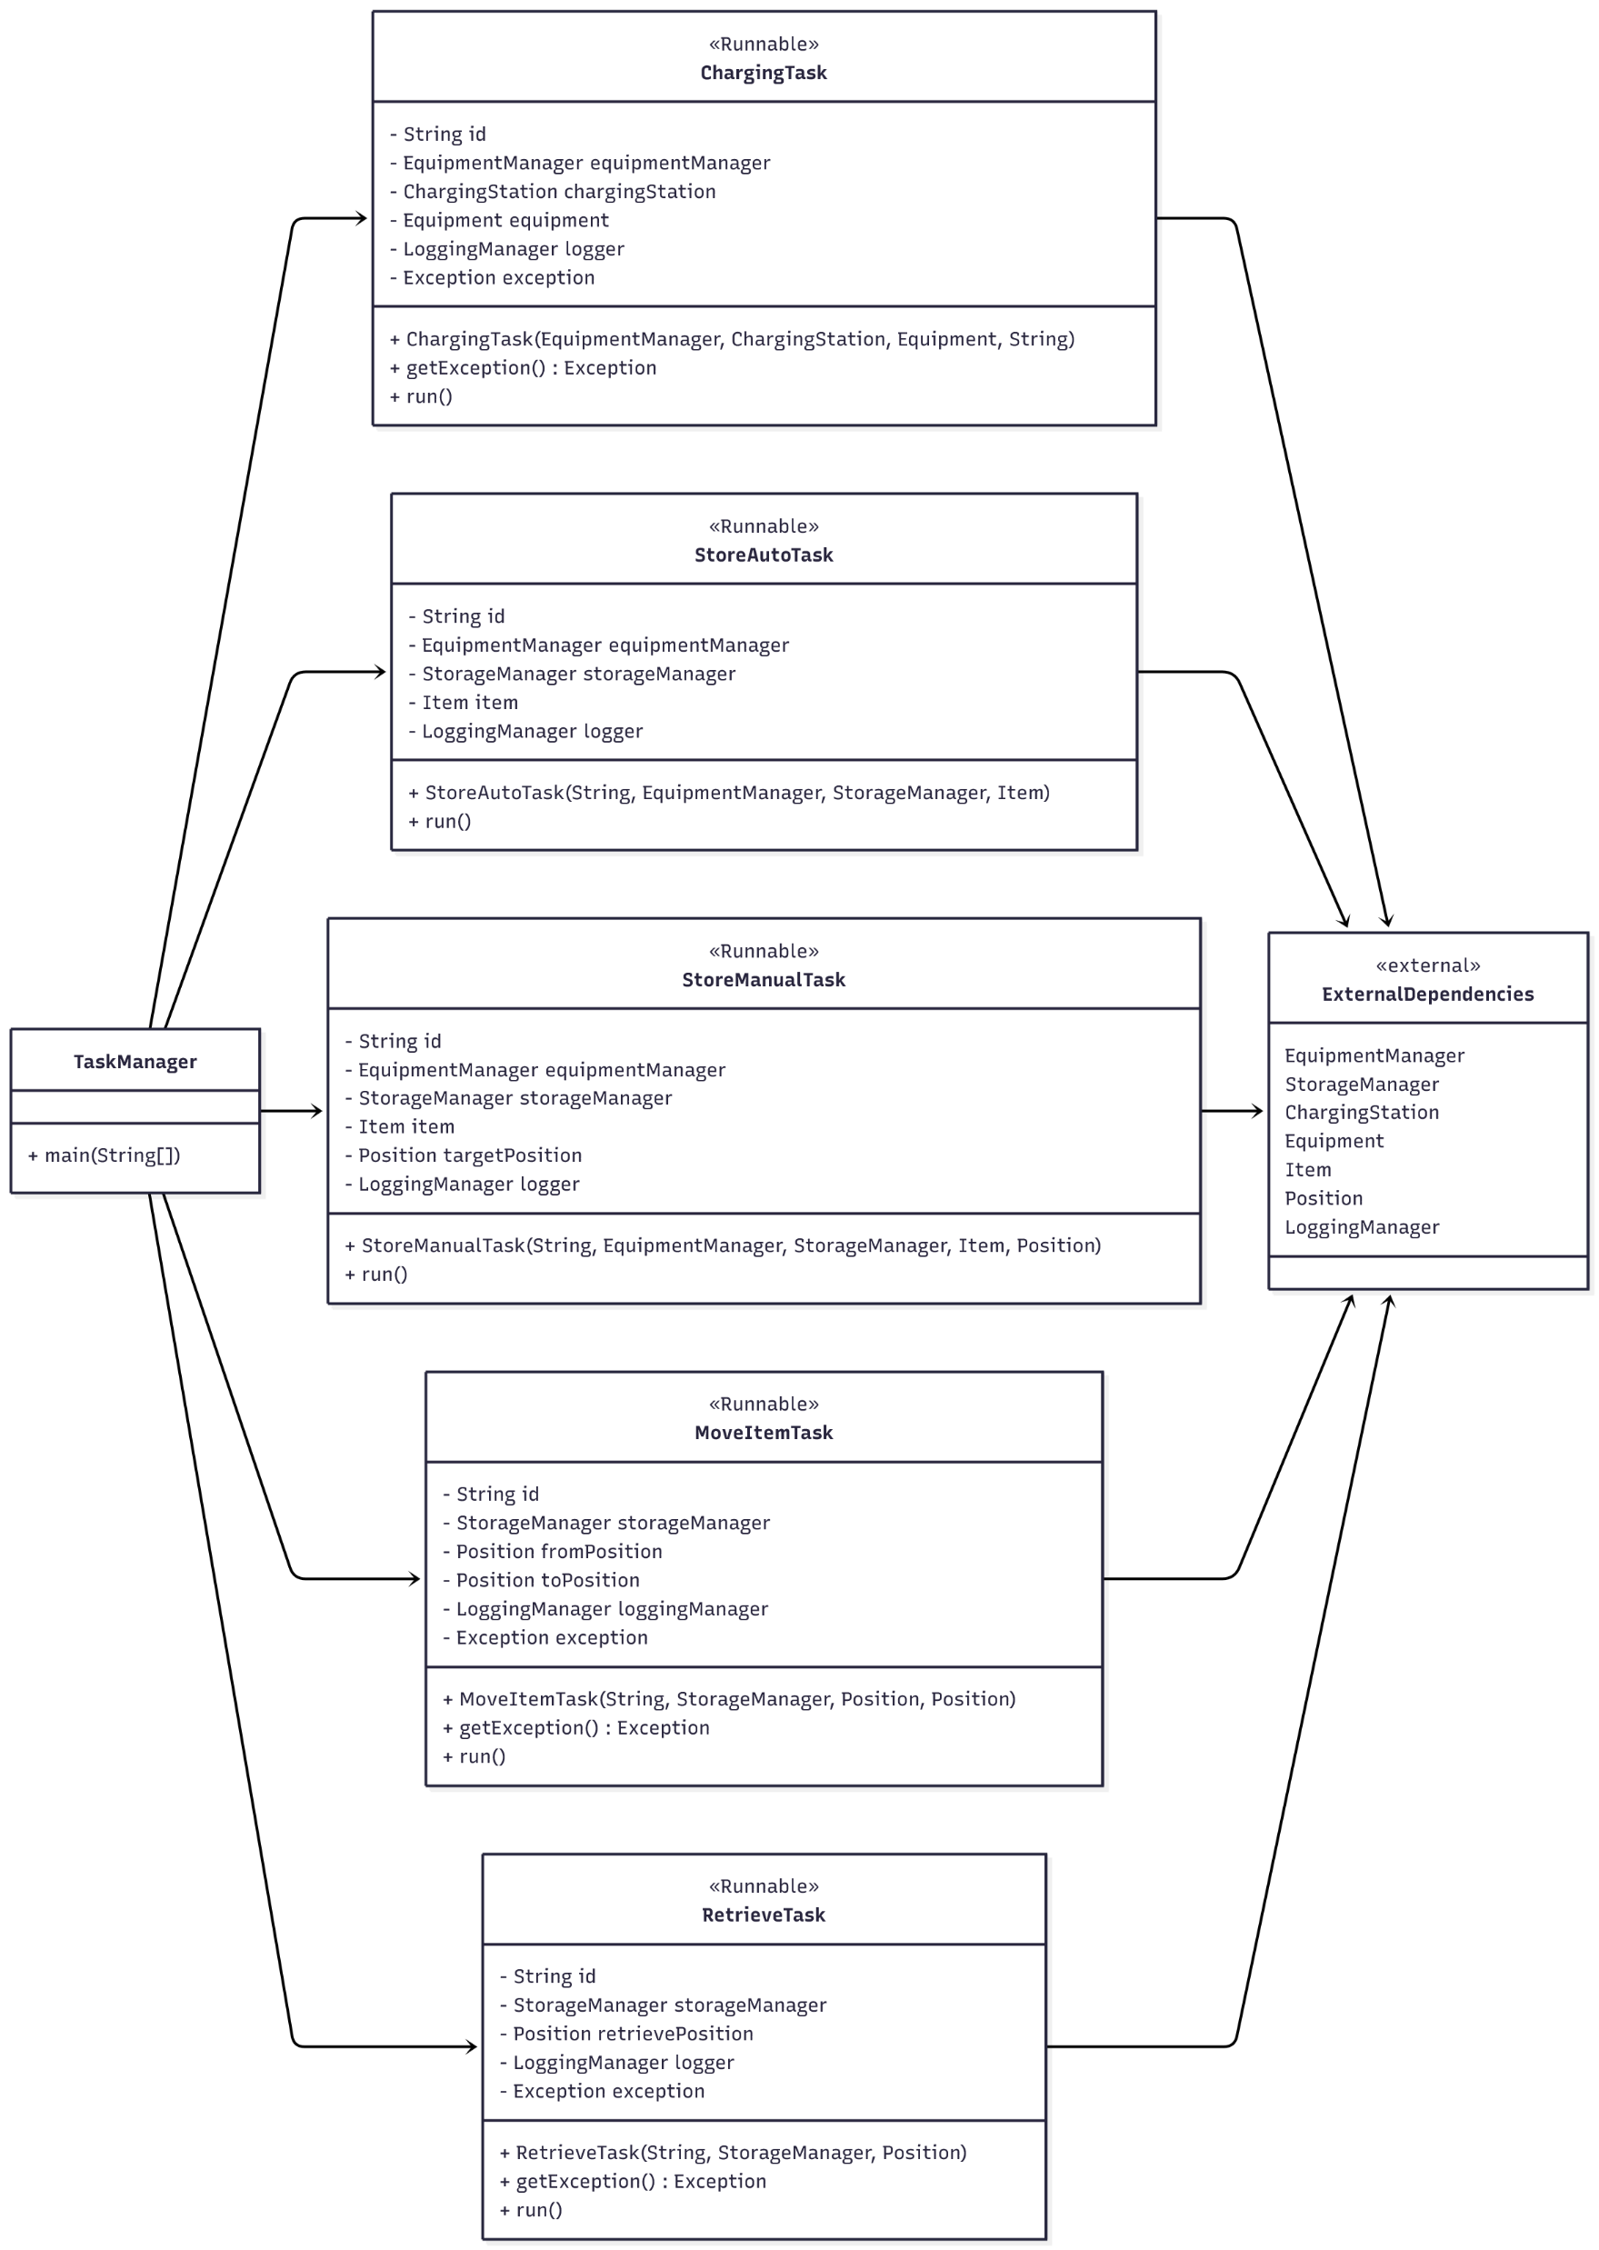
UML Class Diagram
Charging Task
Store Auto Task
Store Manual Task
Move Item Task
Retrieve Item Task

Slide 26
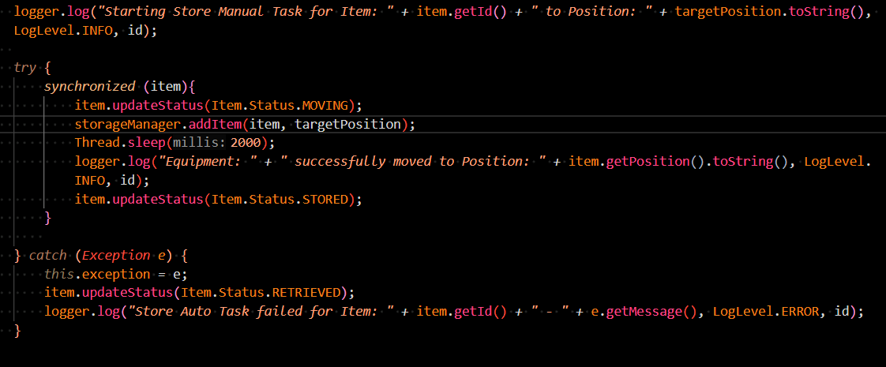
Thread Safe Approach

Slide 27
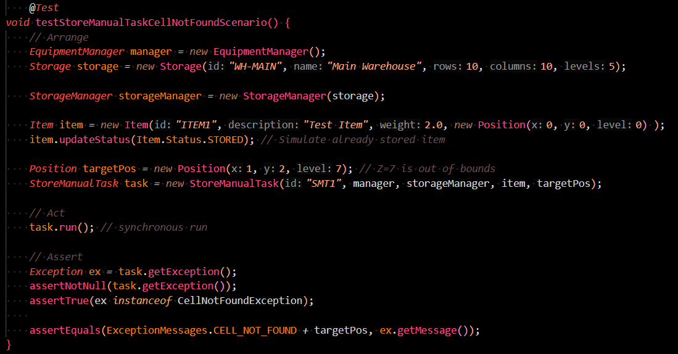
Unit Tests

Slide 28
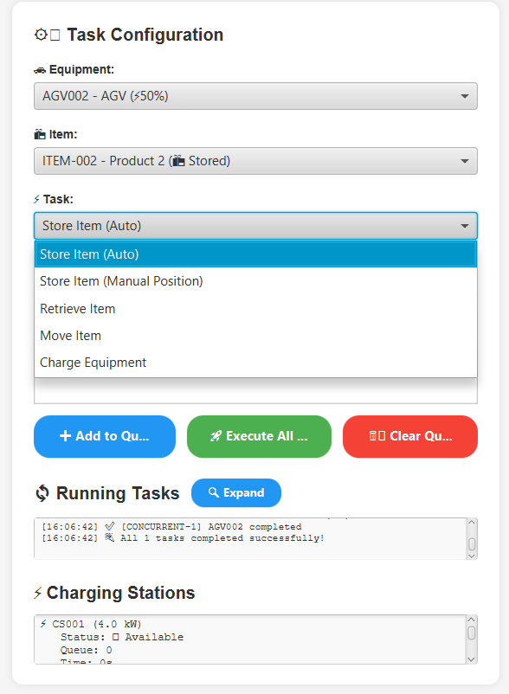
Task in GUI

Slide 29
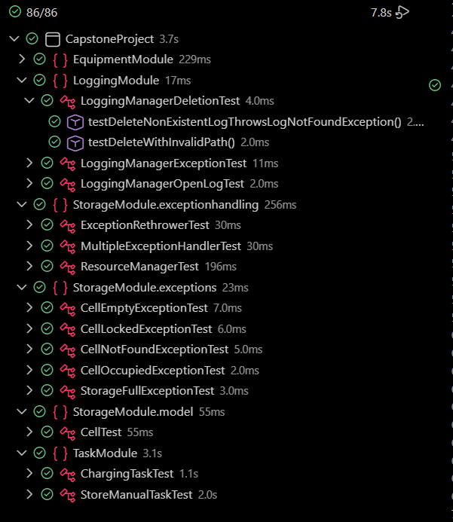
Unit Test Results of System

Slide 30
Thank You for Attention Presented by Team 11
Link for Github: https://github.com/AliFarzi/CapstoneProject

